Slide 1

Scarlet Navigator
Helping Rutgers University students plan their path towards graduation
By Kevin Monisit

Slide 2
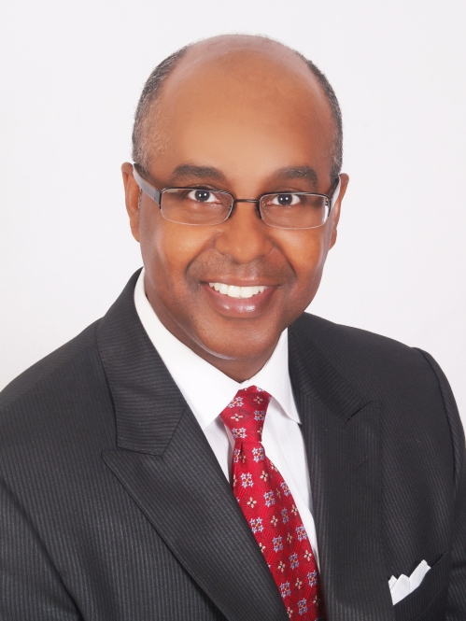
Welcome Dr. Battle
Director of BASW Program
A member of the Curriculum Mapping Subcommittee

Slide 3
AGENDA
I. The Need to be Agile
Why course plans are not set in stone
II. Solutions of the Past
uAchieve
TigerPath and Scarlet Navigator
Curriculum Mapping Subcommittee
Virtual Academic Advisor
III. Solution of the Future
Improvements
IV. Cost of Student Success
Budget (hosting, development, etc.)
V. Why Now?

Slide 4
The need to be Agile Why your plan is subject to change

Slide 5
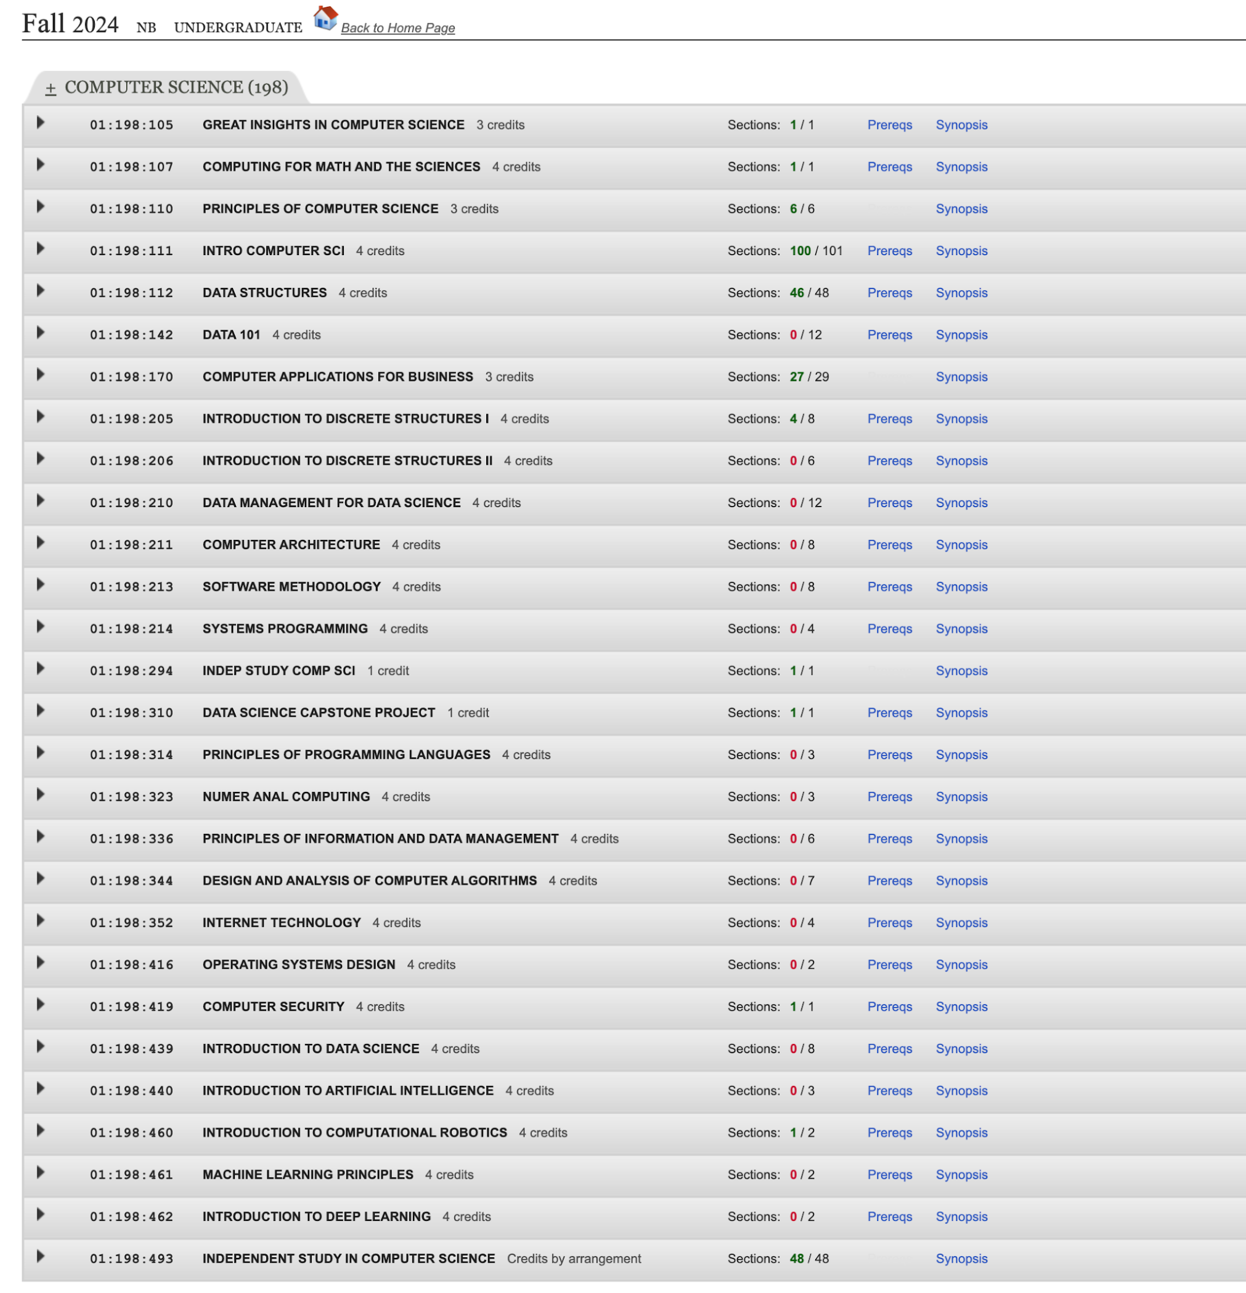
The need to be Agile
Uncertainties
(Rutgers, 2024)

Slide 6

The need to be Agile
Uncertainties
Of 16 electives, 2 sections are open.
29 lecturers in the New Brunswick Writing program have lost their job
“number of Writing Program sections being offered next fall is drastically lower than last fall”
(Rutgers, 2024; Rutgers AAUP-AFT, 2024)

Slide 7

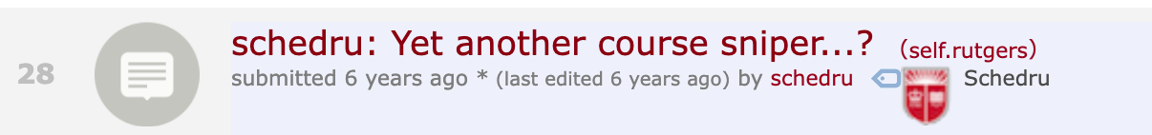
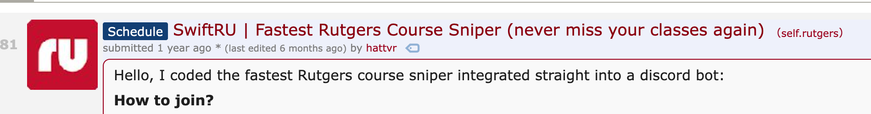
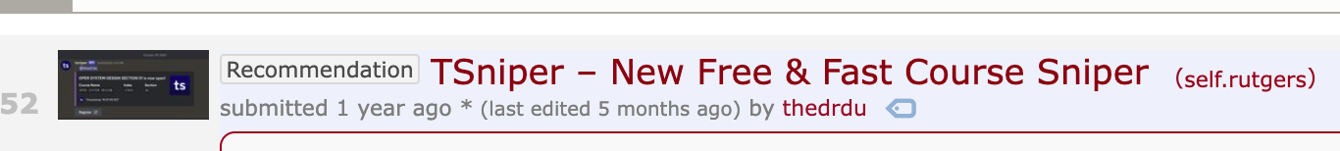
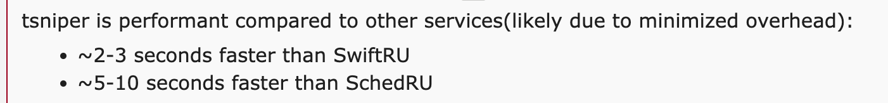
The need to be Agile
Uncertainties
Of 16 electives, 2 CS elective sections are open.
29 lecturers in the New Brunswick Writing program have lost their job
“number of Writing Program sections being offered next fall is drastically lower than last fall”
Students resort to course “snipers”
(Rutgers, 2024; Rutgers AAUP-AFT, 2024; hattvr, 2023; better_off_now, 2021; schedru, 2018; thedru, 2023)

Slide 8
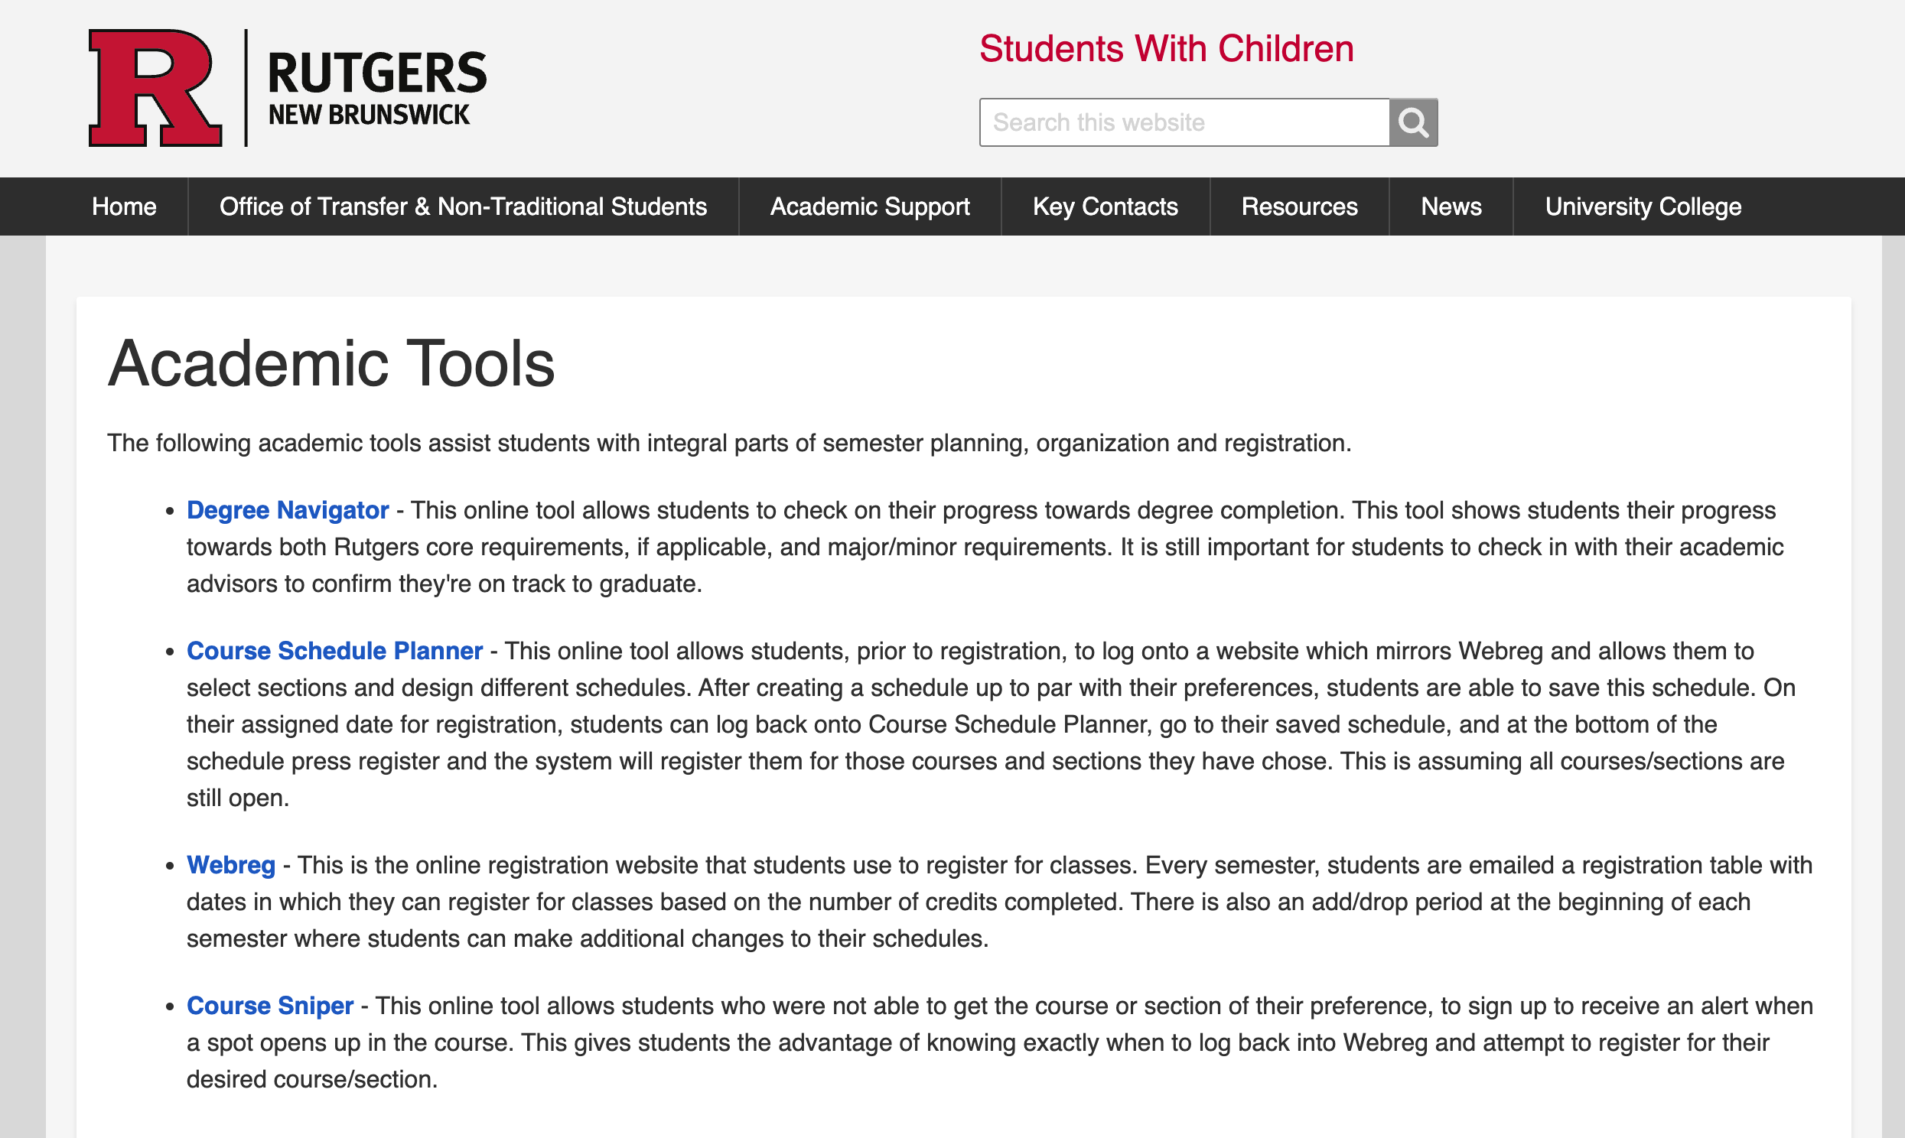
The need to be Agile
Uncertainties
Of 16 electives, 2 CS elective sections are open.
29 lecturers in the New Brunswick Writing program have lost their job
“number of Writing Program sections being offered next fall is drastically lower than last fall”
Students resort to course “snipers”
(Rutgers, 2024; Rutgers AAUP-AFT, 2024; Rutgers University, n.d.)

Slide 9
The need to be Agile
Uncertainties
Of 16 electives, 2 CS elective sections are open.
29 lecturers in the New Brunswick Writing program have lost their job
“number of Writing Program sections being offered next fall is drastically lower than last fall”
Students resort to course “snipers”
Courses can be cancelled unexpectedly before the semester
Rutgers welcome its largest incoming class (13,500) in Fall 2022 in history (at the time of writing)
Class of 2027: 13,400+ first-year enrollment
Even more competition for courses!
1,050 students withdrew from the university in Spring 2023
Students cited “anticipation of poor academic performance” and other “personal issues”
(Rutgers, 2024; Rutgers AAUP-AFT, 2024; Rutgers University, n.d.; Rutgers University, 2022; Rutgers University 2023a; Rutgers University, 2023b)

Slide 10
Solutions of the past

Slide 11








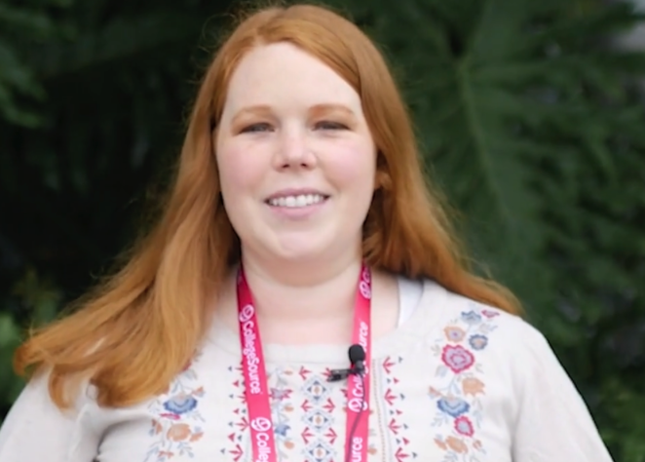




Solutions of the past
+
”[uAchieve helps us] focus on the
whole student and not just the classes
they need to take.”
(CollegeSource, n.d.a, CollegeSource, n.d.b)

Slide 12
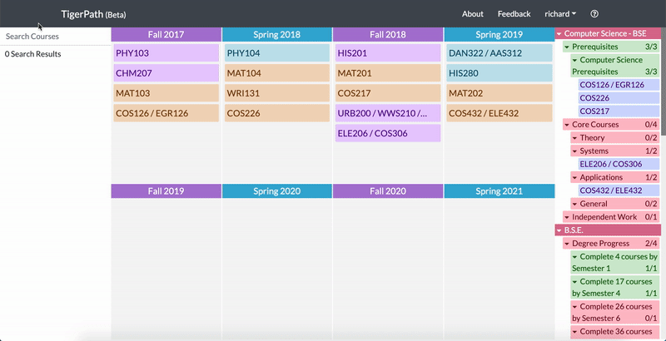
Solutions of the past
TigerPath
Princeton Four Year Course Planner
(Chu et al., 2018)

Slide 13
Solutions of the past
TigerPath
Princeton Four Year Course Planner
Features:
Drag and drop capabilities
Search a course and drop into your schedule
Track major requirements based on planned schedule
Customize requirements fulfilled through AP credits,
summer classes, etc.
(Chu et al., 2018)

Slide 14
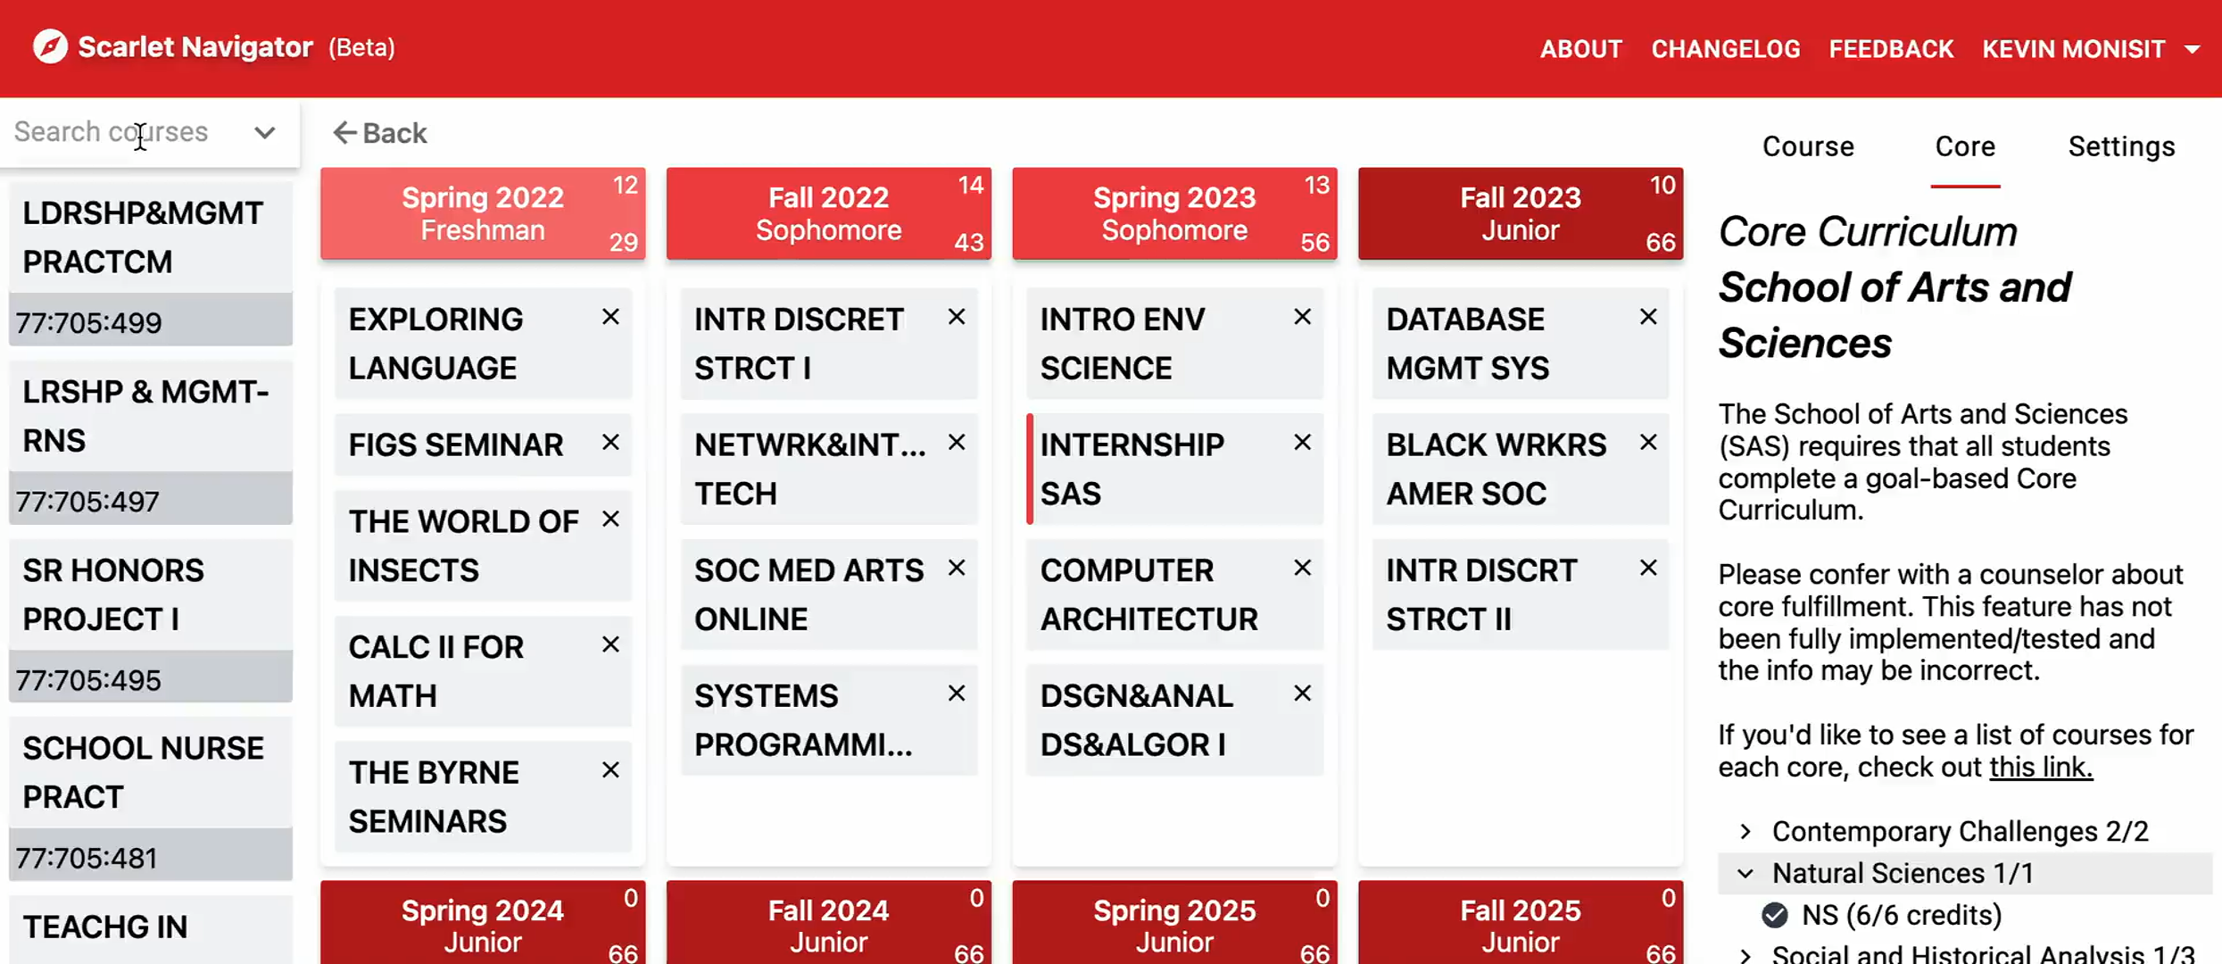
Solutions of the past
TigerPath
Princeton Four Year Course Planner
Scarlet Navigator
Features:
Drag and drop capabilities
Search a course and drop into your schedule
Track major requirements based on planned schedule
Customize requirements fulfilled through AP credits,
summer classes, etc.
Credit tracking per semester and by semester
Accommodates non-traditional students
Display course information on the same page
Save multiple plans
Rutgers X-Year Course Planner
(Chu et al., 2018; Monisit, 2022a)

Slide 15
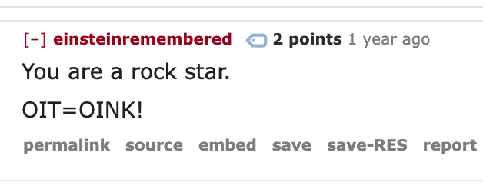
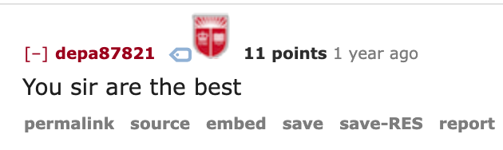
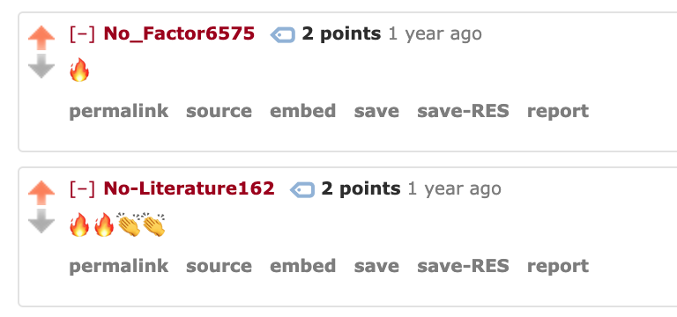
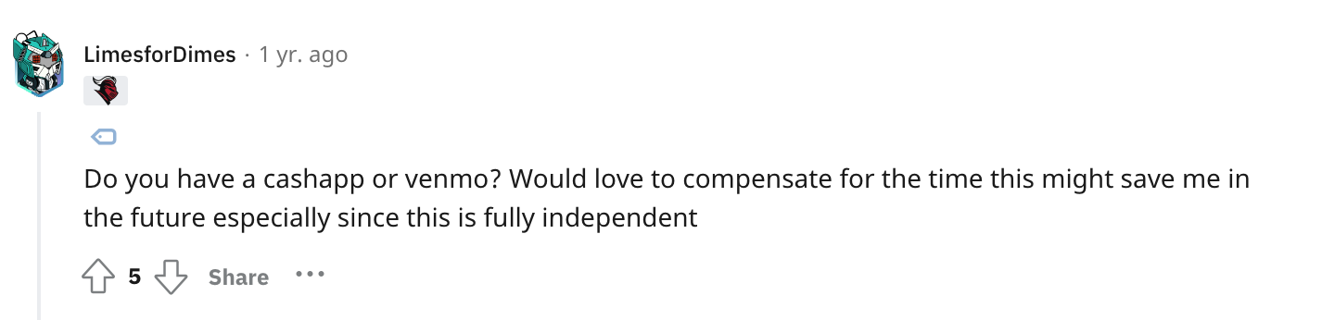
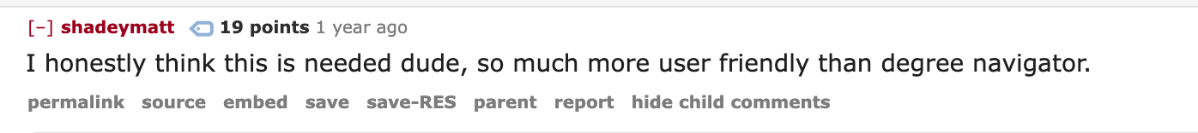
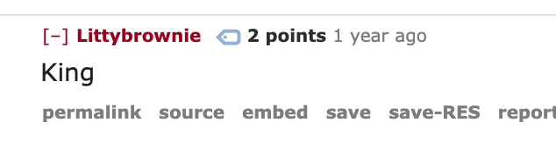
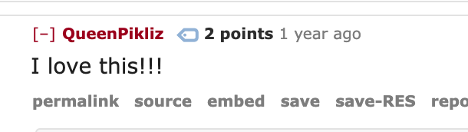
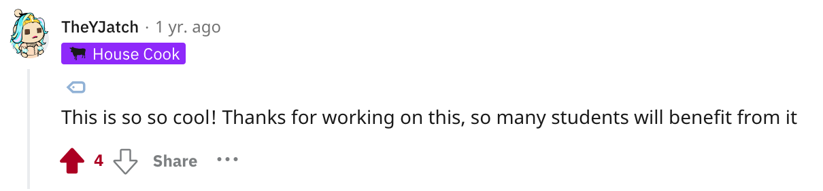
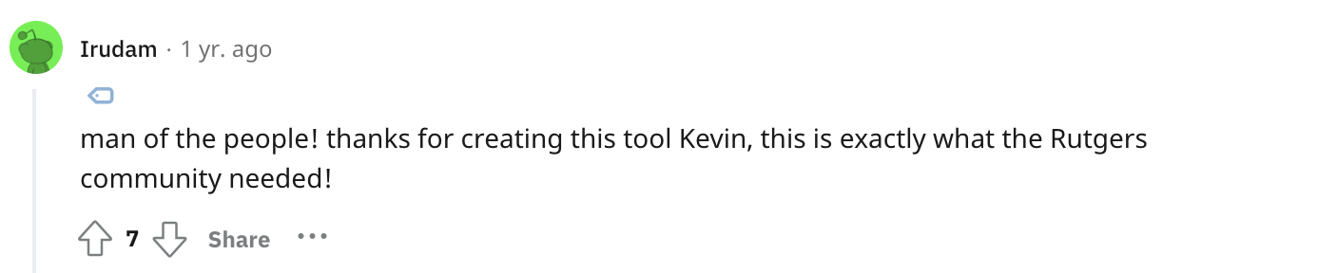
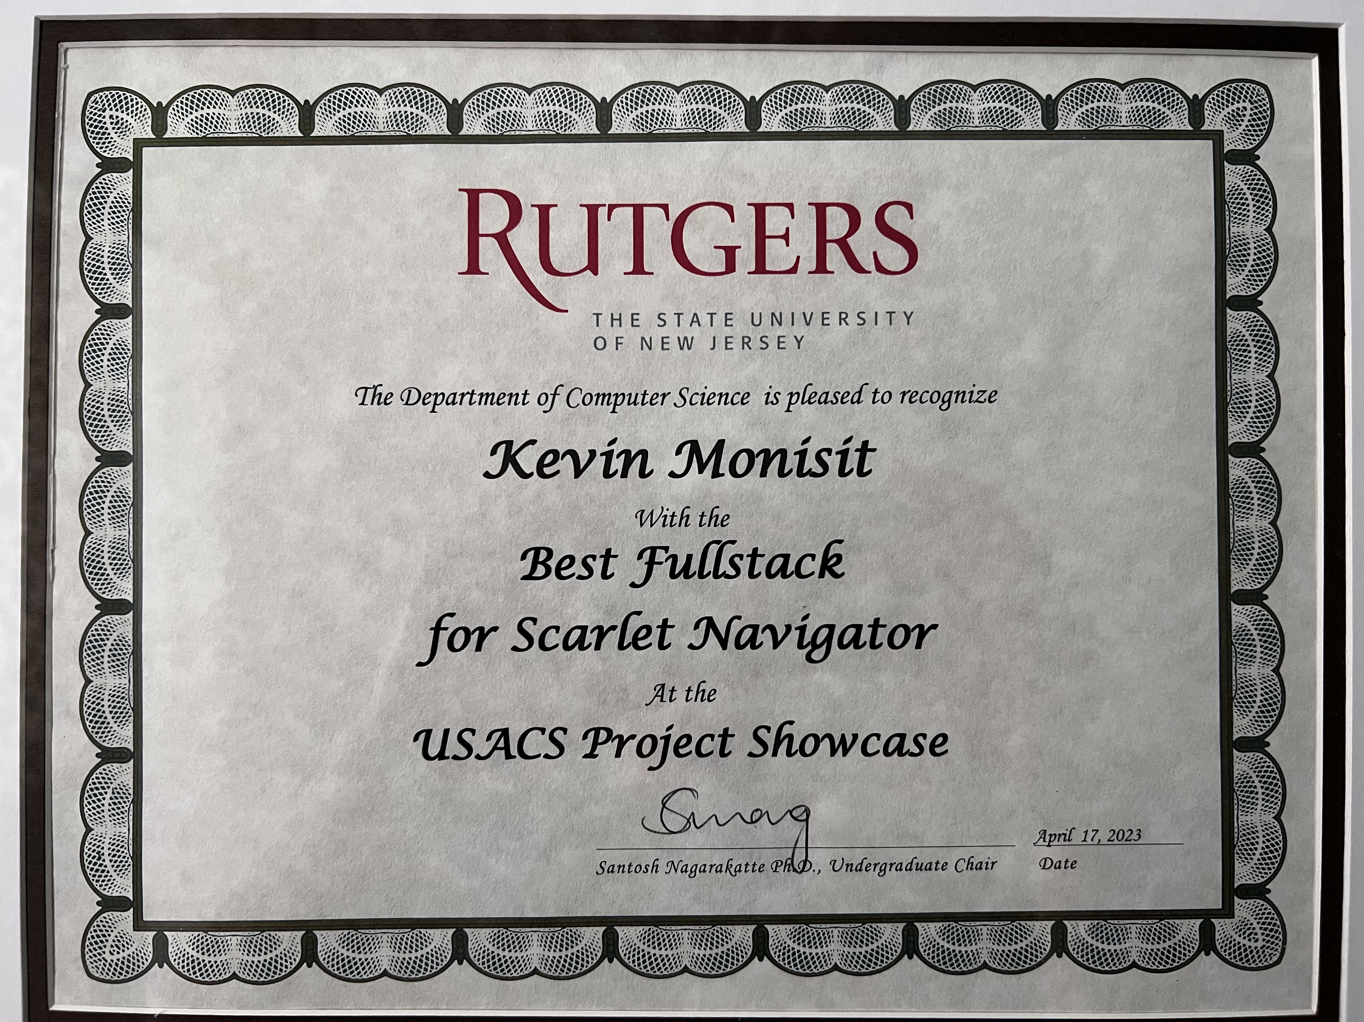
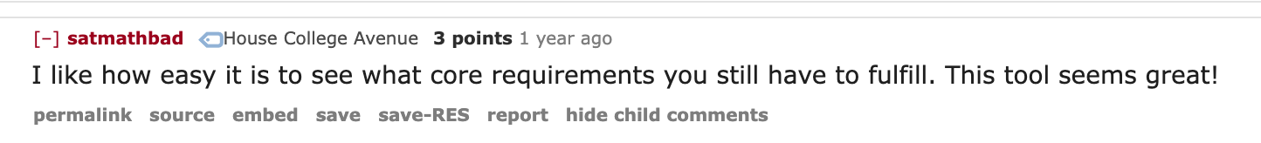
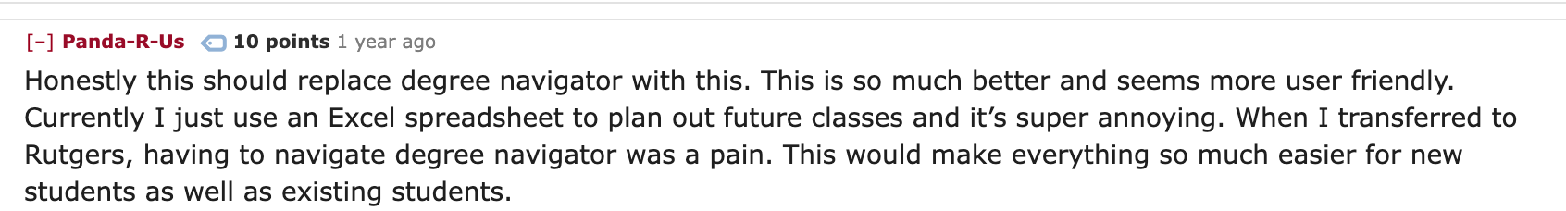
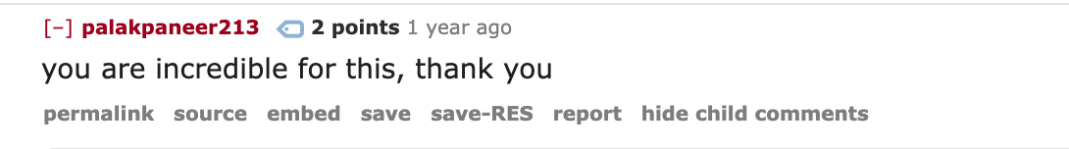
Solutions of the past
Scarlet Navigator
Rutgers X-Year Course Planner
(Chu et al., 2018; Monisit, 2022a, Monisit 2022b)

Slide 16
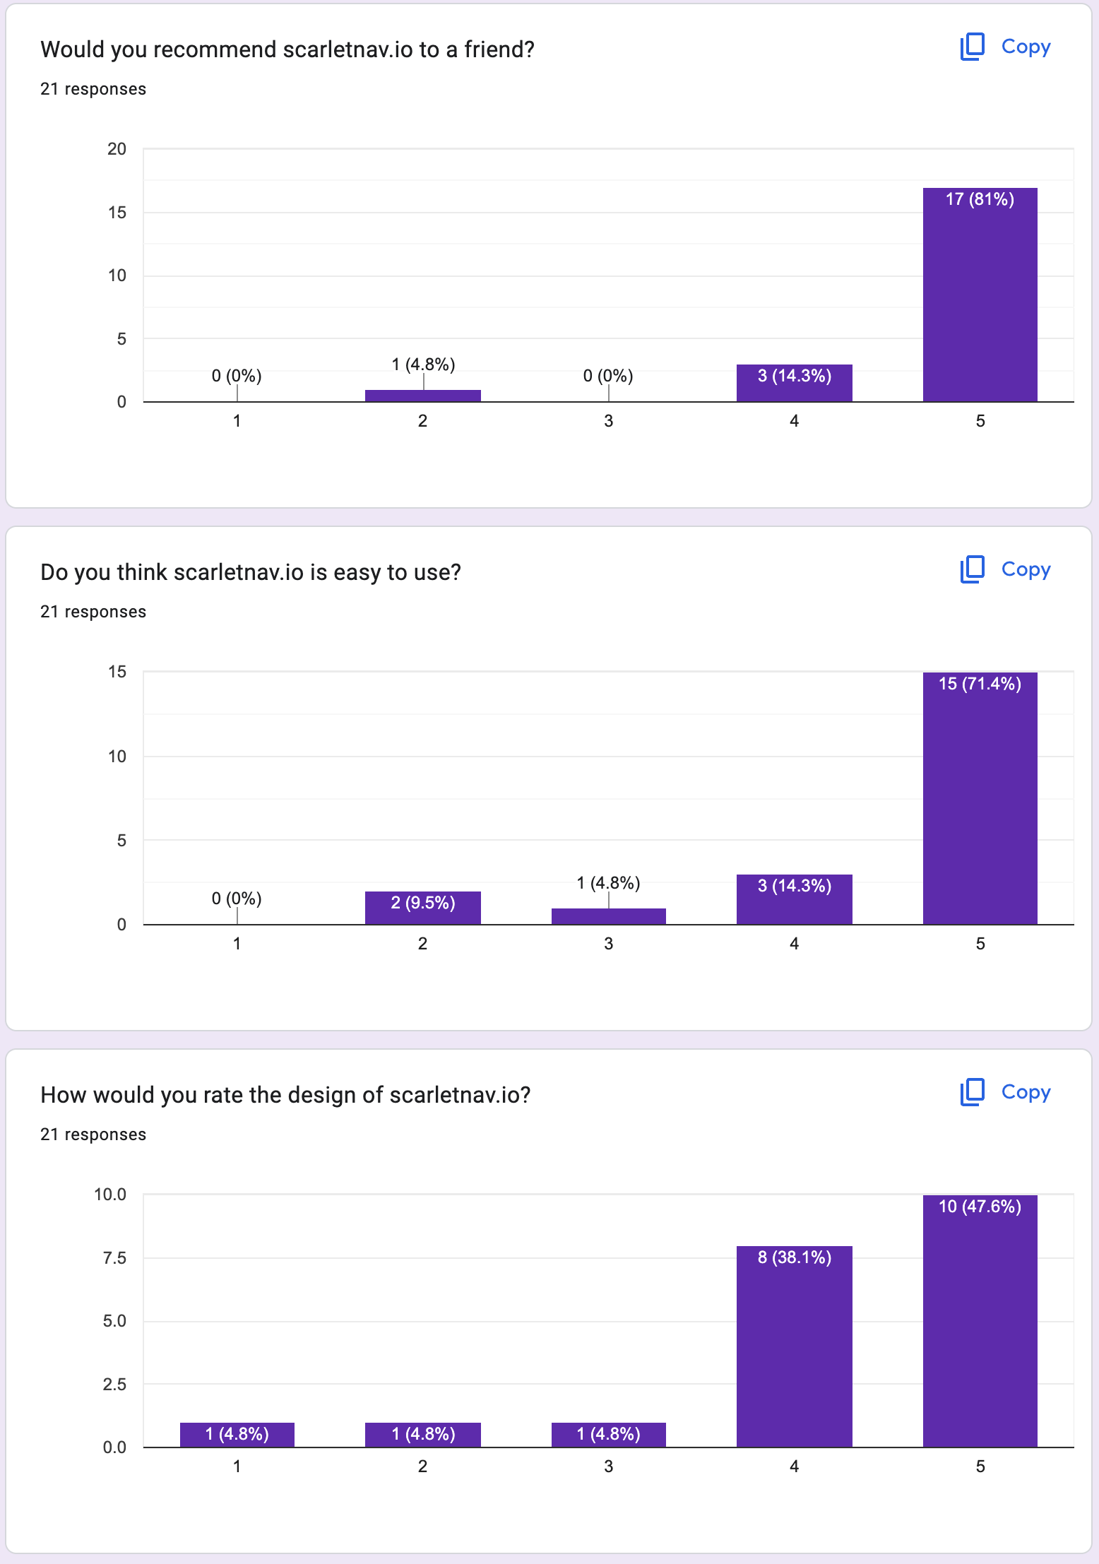
Solutions of the past
Scarlet Navigator
Rutgers X-Year Course Planner
(Monisit, 2022c)

Slide 17
Solutions of the past
Academic Master Plan
4 Pillars of Excellence
Pillar III: Student Success
”Prioritize on-time graduation with minimal debt for all students”
How?
(Rutgers university, 2021)

Slide 18
Solutions of the past
Pillar III: Student Success
Discovery Advantage Initiative
Surveyed …
1,575 faculty and staff
2,440 students of “great diversity”
Curriculum Mapping Subcommittee
DuWayne Battle, Faculty, School of Social Work
Anita Franzione, Faculty, Edward J. Bloustein School of Planning and Public Policy
Martha Haviland, Faculty, School of Arts and Sciences
Francis Lewis, Staff, School of Arts and Sciences
Michelle Neumyer, Staff, School of Arts and Sciences
Faustina Owoh, Student, School of Arts and Sciences
Sharon Stoerger, Senior Administrator, School of Communication and Information
Kristen Syrett, Faculty, School of Arts and Sciences
Saundra Tomlinson-Clarke, Senior Administrator, Academic and Faculty Affairs
Elin Wicks, Faculty, School of Engineering
(Rutgers university, 2021)

Slide 19
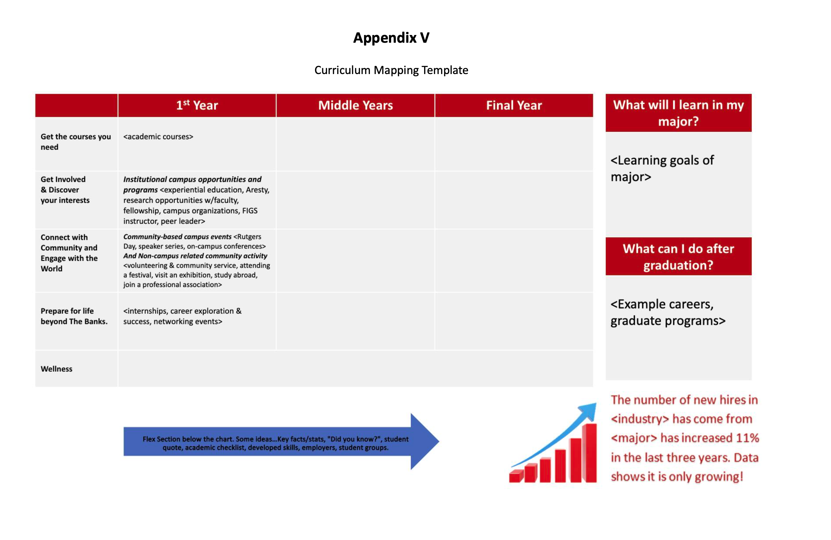
Solutions of the past
Curriculum Mapping Subcommittee
Task: Develop “major maps” to clearly identify academic and/or career pathways
Recommendations:
6.1: Adopt the following template
Do not presuppose year
General version can be further customized
Emphasize opportunities at
certain milestones
(Rutgers university, 2021)

Slide 20
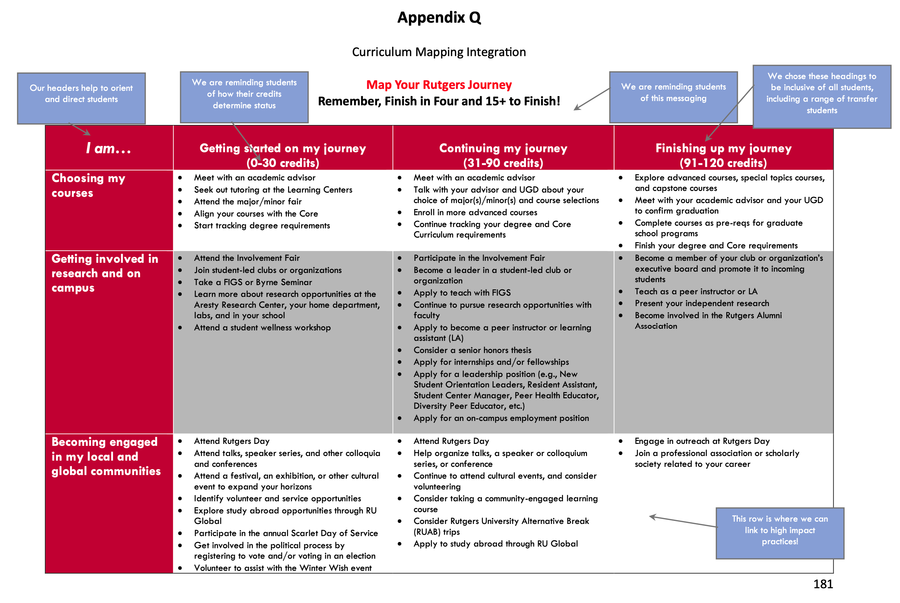
Solutions of the past
Curriculum Mapping Subcommittee
Task: Develop “major maps” to clearly identify academic and/or career pathways
Recommendations:
6.1: Adopt the following template
6.4: Make the curriculum map “interactive” so that students are “empowered to build an advising map based on their own desired pathways”
(Rutgers university, 2021)

Slide 21

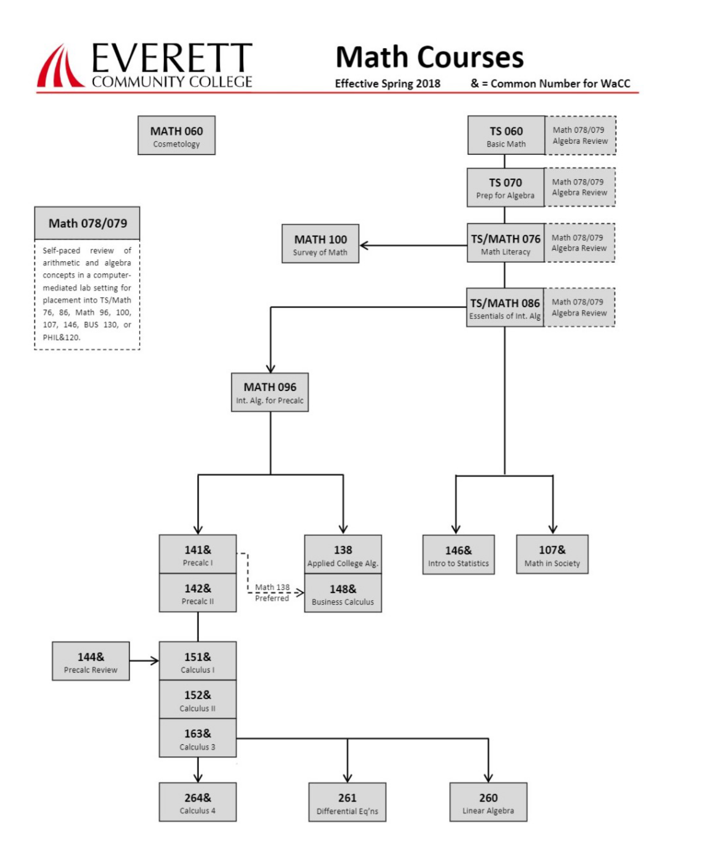
Solutions of the past
The Virtual Academic Advisor System
Use machine learning to recommend majors and course sequences to students
Validated against prerequisites
(Vijjapu, 2019)

Slide 22
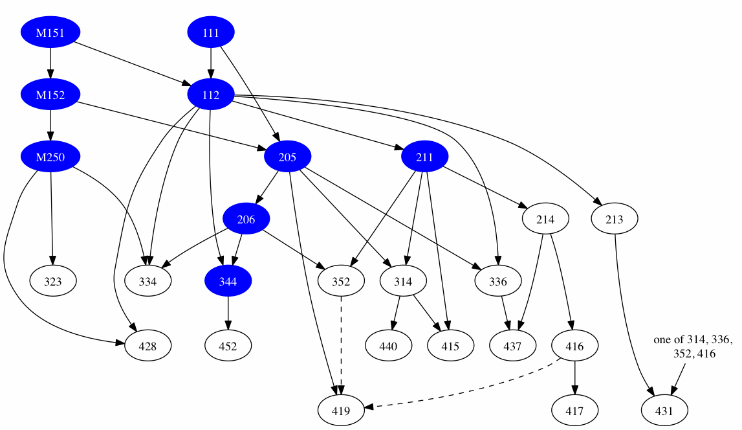
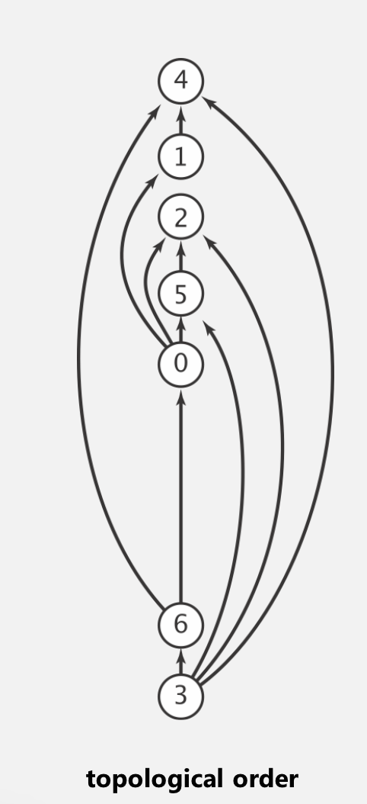
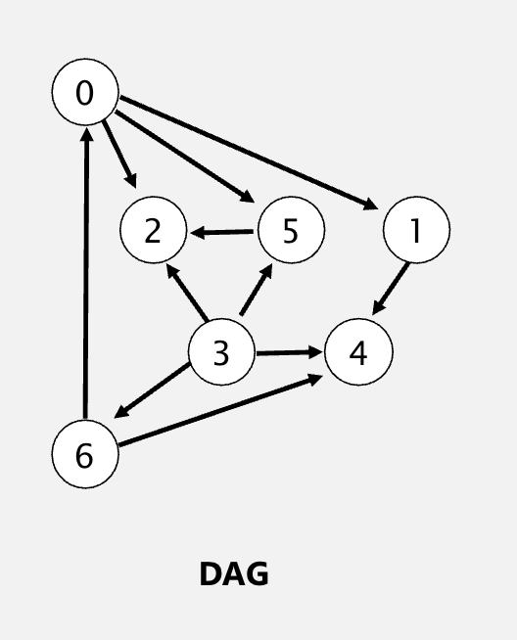
Solutions of the past
The Virtual Academic Advisor System
Validate course sequences by using a directed acyclic graph
Rutgers Computer Science Curriculum
Graph Theory
Topological Sorting
(Vijjapu, 2019; Centeno, n.d.)

Slide 23
Solutions of the past
The Virtual Academic Advisor System
Validate course sequences by using a directed acyclic graph
Rutgers Computer Science Curriculum
Graph Theory
Topological Sorting
Breadth-first Search
(Vijjapu, 2019; Centeno, n.d.)

Slide 24
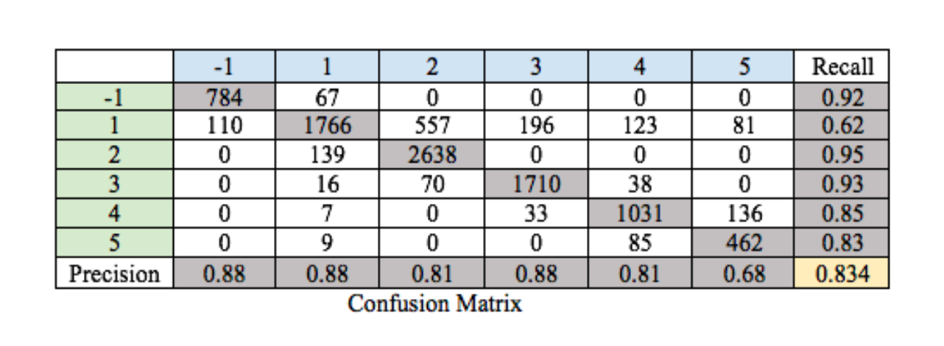
Solutions of the past
The Virtual Academic Advisor System
Results
Mean recall and precision rate of ~83% when compared to human benchmarks (advisor ratings)
(Vijjapu, 2019; Centeno, n.d.)

Slide 25
Paradigm synthesis
Paradigm | Takeaways
uAchieve | Prerequisite validation Sorting majors/minors by progress
TigerPath/Scarlet Navigator | Drag and drop capabilities Fulfilled requirements
Curriculum Subcommittee | Inserting helpful information at critical milestones
Virtual Academic Advisor System | Directed acyclic graph representation for prerequisites

Slide 26
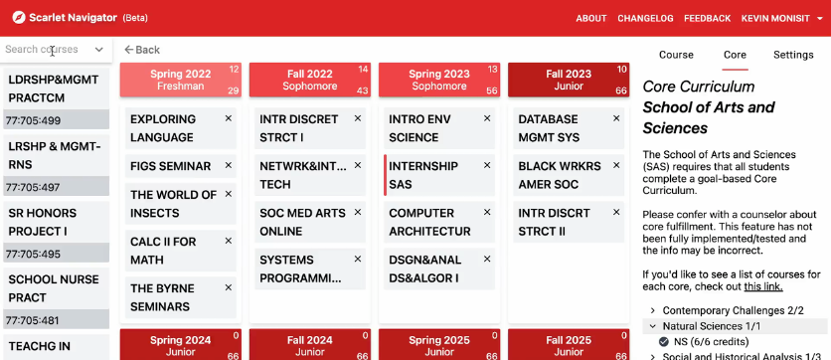
Solution of the future
The base of the solution will be Scarlet Navigator

Slide 27
Solution of the future
The base of the solution will be Scarlet Navigator
Integrate curriculum milestones directly into the schedule (Subcommittee)
Recommendation 6.1: Template
Recommendation 6.4: Interactive

Slide 28
Solution of the future
The base of the solution will be Scarlet Navigator
Integrate curriculum milestones directly into the schedule (Subcommittee)
Recommendation 6.1: Template
Recommendation 6.4: Interactive
0
15
0
30
0
30
0
30
Fall 2022
Freshman
Spring 2023
Freshman
Fall 2023
Freshman
Spring 2024
Freshman

Slide 29
Solution of the future
The base of the solution will be Scarlet Navigator
Integrate curriculum milestones directly into the schedule (Subcommittee)
Recommendation 6.1: Template
Recommendation 6.4: Interactive
0
15
0
30
4
34
0
34
Fall 2022
Freshman
Spring 2023
Freshman
Fall 2023
Sophomore
Spring 2024
Sophomore

Slide 30
Solution of the future
The base of the solution will be Scarlet Navigator
Integrate curriculum milestones directly into the schedule (Subcommittee)
Recommendation 6.1: Template
Recommendation 6.4: Interactive
0
15
0
30
Fall 2022
Freshman
Spring 2023
Freshman
Continuing my Journey!
31 to 90 credits
Meet with an academic advisor
Participate in the Involvement Fair
Apply to teach with FIGS
Consider taking a community-engaged learning course
lorem ispum
4
34
0
34
Fall 2023
Sophomore
Spring 2024
Sophomore

Slide 31
Solution of the future
The base of the solution will be Scarlet Navigator
Integrate curriculum milestones directly into the schedule (Subcommittee)
Recommendation 6.1: Template
Recommendation 6.4: Interactive
0
15
0
30
Fall 2022
Freshman
Spring 2023
Freshman
Continuing my Journey!
31 to 90 credits
Meet with an academic advisor
Participate in the Involvement Fair
Apply to teach with FIGS
Consider taking a community-engaged learning course
lorem ispum
4
34
0
34
Fall 2023
Sophomore
Spring 2024
Sophomore

Slide 32
Solution of the future
The base of the solution will be Scarlet Navigator
Integrate curriculum milestones directly into the schedule (Subcommittee)
Recommendation 6.1: Template
Recommendation 6.4: Interactive
0
15
0
30
Fall 2022
Freshman
Spring 2023
Freshman
Continuing my Journey!
31 to 90 credits
Meet with an academic advisor
Participate in the Involvement Fair
Apply to teach with FIGS
Consider taking a community-engaged learning course
lorem ispum
4
34
0
34
Fall 2023
Sophomore
Spring 2024
Sophomore

Slide 33
Solution of the future
The base of the solution will be Scarlet Navigator
Integrate curriculum milestones directly into the schedule (Subcommittee)
Recommendation 6.1: Template
Recommendation 6.4: Interactive
0
15
0
30
Fall 2022
Freshman
Spring 2023
Freshman
Continuing my Journey!
31 to 90 credits
Meet with an academic advisor
Participate in the Involvement Fair
Apply to teach with FIGS
Consider taking a community-engaged learning course
lorem ispum
4
34
0
34
Fall 2023
Sophomore
Spring 2024
Sophomore

Slide 34
Solution of the future
The base of the solution will be Scarlet Navigator
Integrate curriculum milestones directly into the schedule (Subcommittee)
Recommendation 6.1: Template
Recommendation 6.4: Interactive
0
15
0
30
Fall 2022
Freshman
Spring 2023
Freshman
Continuing my Journey!
31 to 90 credits
6.1:
Years are not presupposed since the schedule itself is dynamic
Meet with an academic advisor
Participate in the Involvement Fair
Apply to teach with FIGS
Consider taking a community-engaged learning course
lorem ispum
4
34
0
34
Fall 2023
Sophomore
Spring 2024
Sophomore

Slide 35
Solution of the future
The base of the solution will be Scarlet Navigator
Integrate curriculum milestones directly into the schedule (Subcommittee)
Integrate prerequisite validation via a graph search (uAchieve and VAA)
0
15
0
30
Fall 2022
Freshman
Spring 2023
Freshman
Continuing my Journey!
31 to 90 credits
Meet with an academic advisor
Participate in the Involvement Fair
Apply to teach with FIGS
Consider taking a community-engaged learning course
lorem ispum
4
34
0
34
Fall 2023
Sophomore
Spring 2024
Sophomore

Slide 36
Solution of the future
The base of the solution will be Scarlet Navigator
Integrate curriculum milestones directly into the schedule (Subcommittee)
Integrate prerequisite validation via cyclic graph detection (uAchieve and VAA)
E
0
15
0
30
Fall 2022
Freshman
Spring 2023
Freshman
Continuing my Journey!
31 to 90 credits
A
A
B
Meet with an academic advisor
Participate in the Involvement Fair
Apply to teach with FIGS
Consider taking a community-engaged learning course
lorem ispum
C
E
B
4
34
0
34
Fall 2023
Sophomore
Spring 2024
Sophomore
C

Slide 37
Solution of the future
The base of the solution will be Scarlet Navigator
Integrate curriculum milestones directly into the schedule (Subcommittee)
Integrate prerequisite validation via cyclic graph detection (uAchieve and VAA)
E
0
15
0
30
Fall 2022
Freshman
Spring 2023
Freshman
Continuing my Journey!
31 to 90 credits
A
A
C
Meet with an academic advisor
Participate in the Involvement Fair
Apply to teach with FIGS
Consider taking a community-engaged learning course
lorem ispum
C
E
B
4
34
0
34
Fall 2023
Sophomore
Spring 2024
Sophomore
B

Slide 38
Solution of the future
The base of the solution will be Scarlet Navigator
Integrate curriculum milestones directly into the schedule (Subcommittee)
Integrate prerequisite validation via cyclic graph detection (uAchieve and VAA)
Breadth-First Search
0
15
0
30
Fall 2022
Freshman
Spring 2023
Freshman
Continuing my Journey!
31 to 90 credits
E
A
C
Meet with an academic advisor
Participate in the Involvement Fair
Apply to teach with FIGS
Consider taking a community-engaged learning course
lorem ispum
A
E
C
B
4
34
0
34
Fall 2023
Sophomore
Spring 2024
Sophomore
B

Slide 39
Solution of the future
The base of the solution will be Scarlet Navigator
Integrate curriculum milestones directly into the schedule (Subcommittee)
Integrate prerequisite validation via cyclic graph detection (uAchieve and VAA)
Breadth-First Search
0
15
0
30
Fall 2022
Freshman
Spring 2023
Freshman
Continuing my Journey!
31 to 90 credits
E
A
C
Meet with an academic advisor
Participate in the Involvement Fair
Apply to teach with FIGS
Consider taking a community-engaged learning course
lorem ispum
A
E
C
B
4
34
0
34
Fall 2023
Sophomore
Spring 2024
Sophomore
B

Slide 40

Solution of the future
The base of the solution will be Scarlet Navigator
Integrate curriculum milestones directly into the schedule (Subcommittee)
Integrate prerequisite validation via cyclic graph detection (uAchieve and VAA)
Breadth-First Search
0
15
0
30
Fall 2022
Freshman
Spring 2023
Freshman
Continuing my Journey!
31 to 90 credits
E
A
C
Meet with an academic advisor
Participate in the Involvement Fair
Apply to teach with FIGS
Consider taking a community-engaged learning course
lorem ispum
A
E
C
B
4
34
0
34
Fall 2023
Sophomore
Spring 2024
Sophomore
B

Slide 41
Solution of the future
The base of the solution will be Scarlet Navigator
Integrate curriculum milestones directly into the schedule (Subcommittee)
Integrate prerequisite validation via cyclic graph detection (uAchieve and VAA)
Let the user know with indicators!
Breadth-First Search
0
15
0
30
Fall 2022
Freshman
Spring 2023
Freshman
Continuing my Journey!
31 to 90 credits
E
A
C
Meet with an academic advisor
Participate in the Involvement Fair
Apply to teach with FIGS
Consider taking a community-engaged learning course
lorem ispum
A
E
C
B
4
34
0
34
Fall 2023
Sophomore
Spring 2024
Sophomore
B

Slide 42
Solution of the future
The base of the solution will be Scarlet Navigator
Integrate curriculum milestones directly into the schedule (Subcommittee)
Integrate prerequisite validation via cyclic graph detection (uAchieve and VAA)
Search and sort majors by total progress
0
15
0
30
Fall 2022
Freshman
Spring 2023
Freshman
Continuing my Journey!
31 to 90 credits
A
C
Meet with an academic advisor
Participate in the Involvement Fair
Apply to teach with FIGS
Consider taking a community-engaged learning course
lorem ispum
E
4
34
0
34
Fall 2023
Sophomore
Spring 2024
Sophomore
B

Slide 43
Solution of the future
The base of the solution will be Scarlet Navigator
Integrate curriculum milestones directly into the schedule (Subcommittee)
Integrate prerequisite validation via cyclic graph detection (uAchieve and VAA)
Search and sort majors by total progress (uAchieve -> led to 23% increase in credential production!)
Majors
0
15
0
30
Fall 2022
Freshman
Spring 2023
Freshman
Continuing my Journey!
31 to 90 credits
Major 1
A
C
Meet with an academic advisor
Participate in the Involvement Fair
Apply to teach with FIGS
Consider taking a community-engaged learning course
lorem ispum
E
67%
Major 2
20%
Major 3
4
34
0
34
Fall 2023
Sophomore
Spring 2024
Sophomore
87%
B
Major 4
48%

Slide 44
Solution of the future
The base of the solution will be Scarlet Navigator
Integrate curriculum milestones directly into the schedule (Subcommittee)
Integrate prerequisite validation via cyclic graph detection (uAchieve and VAA)
Search and sort majors by total progress (uAchieve -> led to 23% increase in credential production!)
Majors
0
15
0
30
Fall 2022
Freshman
Spring 2023
Freshman
Continuing my Journey!
31 to 90 credits
Major 3
A
C
Meet with an academic advisor
Participate in the Involvement Fair
Apply to teach with FIGS
Consider taking a community-engaged learning course
lorem ispum
E
87%
Major 1
67%
Major 4
4
34
0
34
Fall 2023
Sophomore
Spring 2024
Sophomore
48%
B
Major 2
20%

Slide 45
Solution of the future
The base of the solution will be Scarlet Navigator
Integrate curriculum milestones directly into the schedule (Subcommittee)
Integrate prerequisite validation via cyclic graph detection (uAchieve and VAA)
Search and sort majors by total progress (uAchieve)
GPA Calculation semester by semester (uAchieve)
Overall GPA
Semester GPA
Majors
2.5
2.5
0
15
2.81
3.20
0
30
Fall 2022
Freshman
Spring 2023
Freshman
Continuing my Journey!
31 to 90 credits
Major 3
A
C
Meet with an academic advisor
Participate in the Involvement Fair
Apply to teach with FIGS
Consider taking a community-engaged learning course
lorem ispum
E
87%
Major 1
67%
Major 4
2.98
3.00
4
34
0
34
Fall 2023
Sophomore
Spring 2024
Sophomore
48%
B
Major 2
20%

Slide 46
Solution of the future
The base of the solution will be Scarlet Navigator
Integrate curriculum milestones directly into the schedule (Subcommittee)
Integrate prerequisite validation via cyclic graph detection (uAchieve and VAA)
Search and sort majors by total progress (uAchieve)
GPA Calculation semester by semester (uAchieve)
Course recommendations (Subcommittee, VAA, and uAchieve)
Majors
2.5
2.5
0
15
2.81
3.20
0
30
Fall 2022
Freshman
Spring 2023
Freshman
Continuing my Journey!
31 to 90 credits
Major 3
A
C
Meet with an academic advisor
Participate in the Involvement Fair
Apply to teach with FIGS
Consider taking a community-engaged learning course
lorem ispum
At this point, you should take the following courses to stay on track for major X:
01:198:101, 01:640:152
E
87%
Major 1
67%
Major 4
2.98
3.00
4
34
0
34
Fall 2023
Sophomore
Spring 2024
Sophomore
48%
B
Major 2
20%

Slide 47
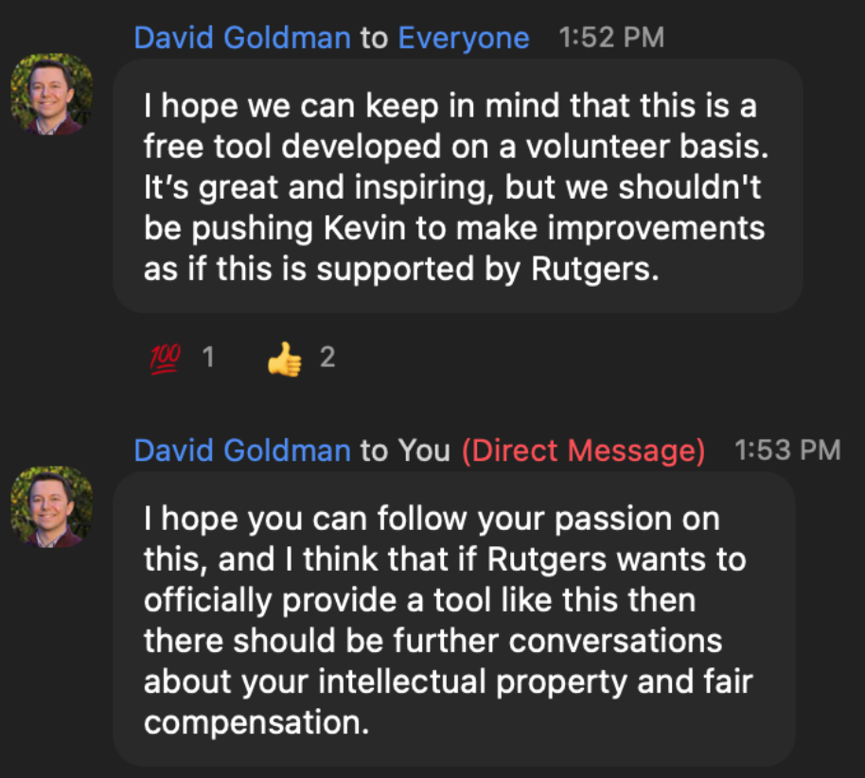
Cost of Student Success
Scarlet Navigator
David Goldman (Director of Teaching, Learning, and Assessment)

Slide 48
Cost of Student Success
Component | Cost
Scarlet Navigator

Slide 49
Cost of Student Success
Component | Cost
Scarlet Navigator | Free!

Slide 50
Cost of Student Success
Component | Cost
Scarlet Navigator | Free!
Development | Free (e.g. volunteer student developers, LCRS, Rutgers OSS)

Slide 51
Cost of Student Success
Component | Cost
Scarlet Navigator | Free!
Development | Free (e.g. volunteer student developers, LCRS, Rutgers OSS)
Hosting

Slide 52
Cost of Student Success
Using Google Firestore (Database) Price Rates
Assume 50,000 users.
Database:
50KB per user (0.05 MB)
0.05MB (per user) * 50,000 = 2500 MB = 2.5GB
All 4,500 courses = 19.1 MB
Database Costs:
2.5 GB + 19.1MB = 2.5191 GB
Non-free tier = 1.5191 GB
1GB-No cost + (1.5191 * 0.18/GB) = $0.27 per month
Component | Cost
Scarlet Navigator | Free!
Development | Free (e.g. volunteer student developers, LCRS, Rutgers OSS)
Hosting

Slide 53
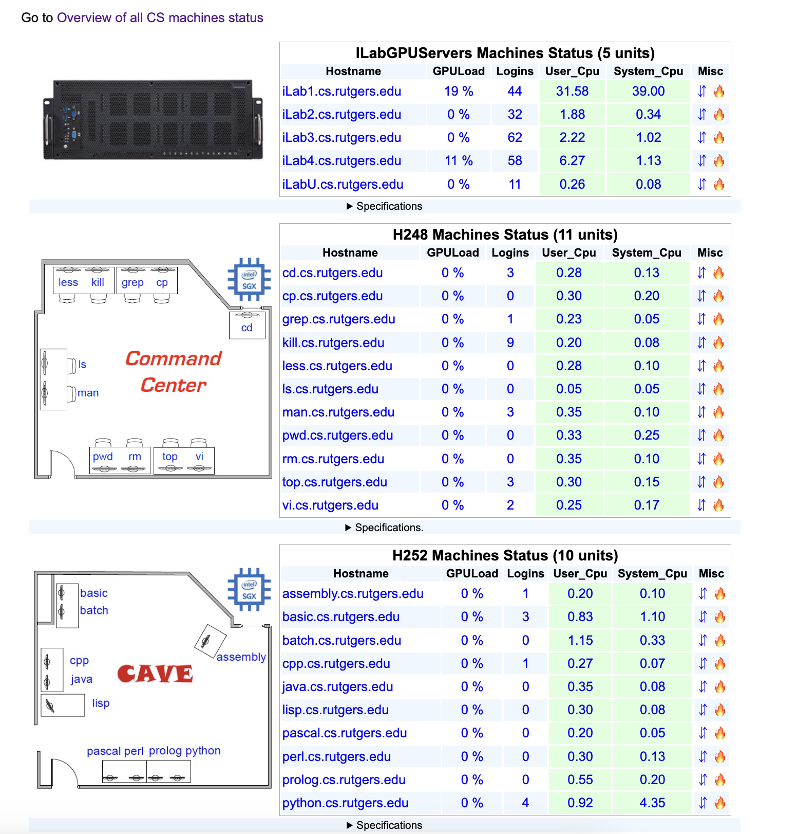
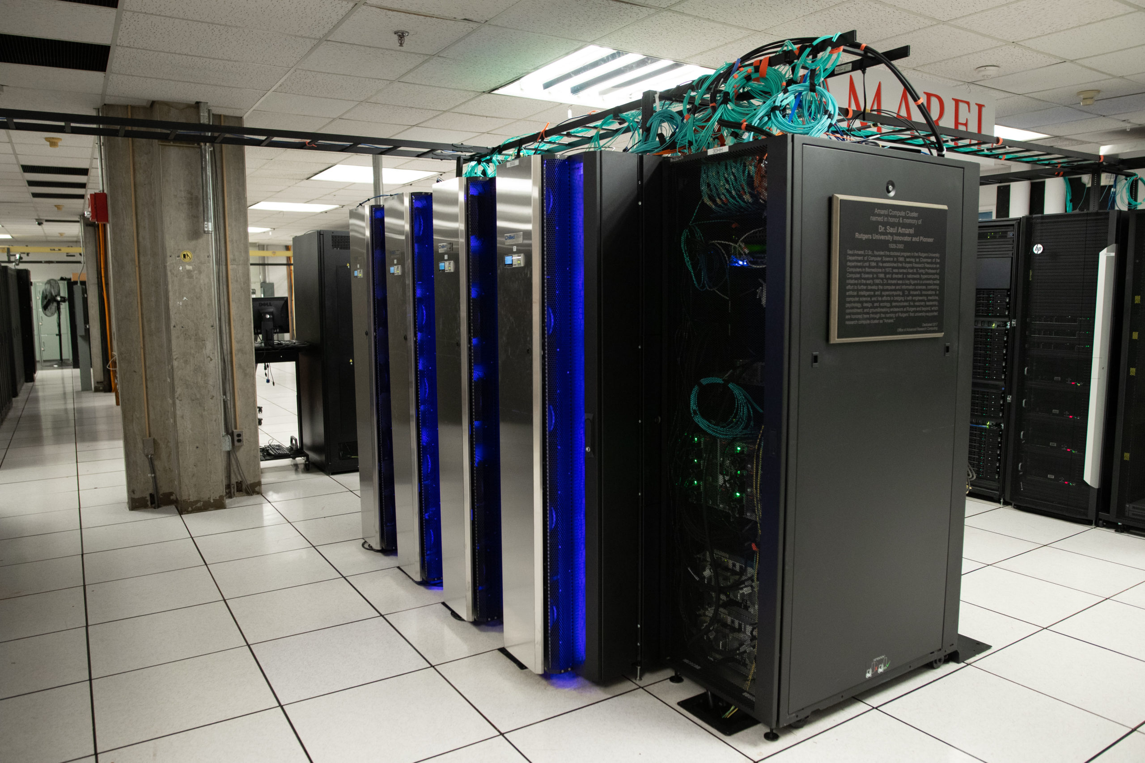
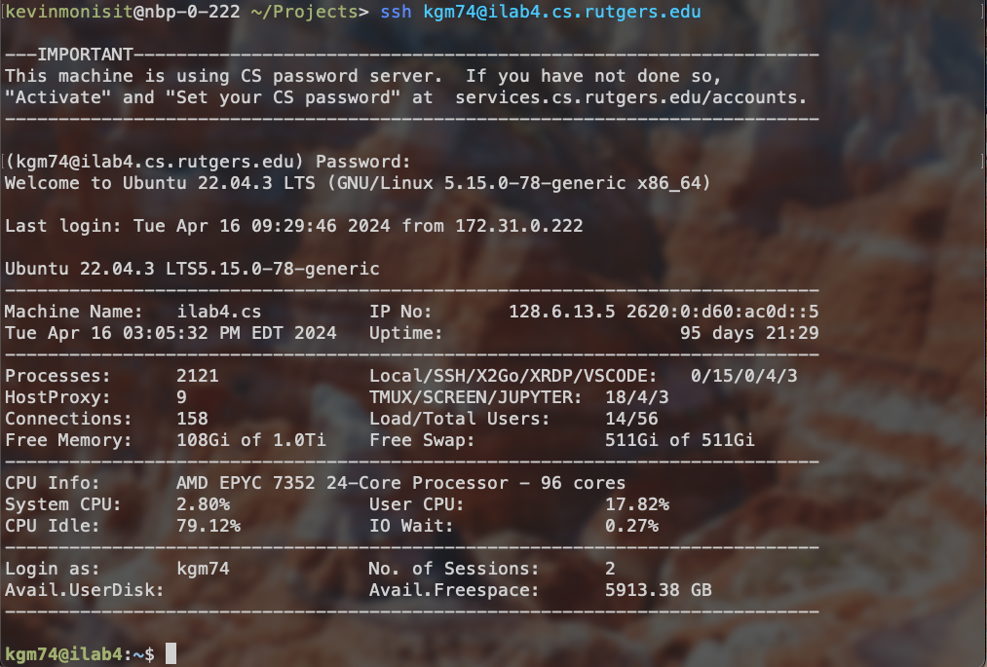
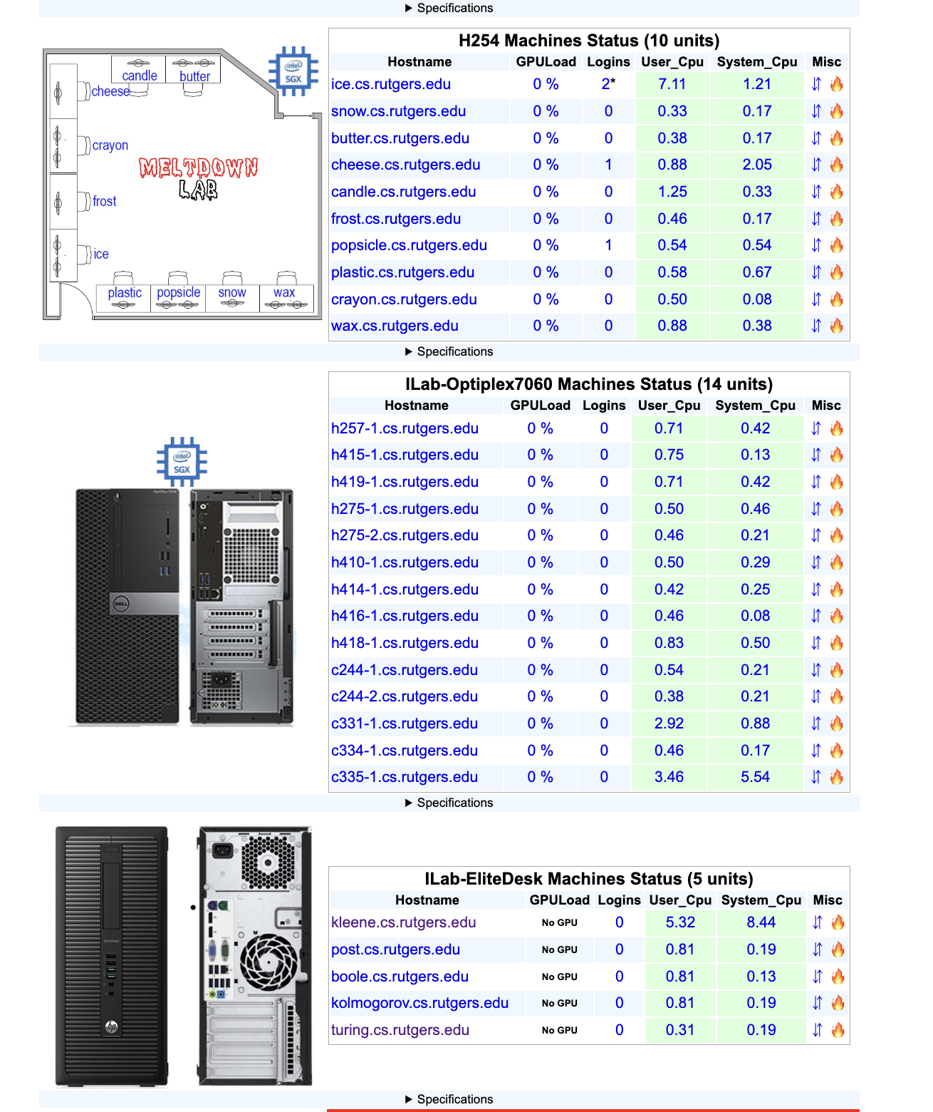

Cost of Student Success
Functions:
Search course
Update schedule
Major sort (constant time)
Assume 50,000 users. Database: ~51 GB for a given year
Functions
20,000 users PER day performing the following operations:
~1 login (Read)
~20 course searches (Read)
~50 schedule updates (Write)
~Major sort (done on client)
Google Firebase Serverless Function Price Rates
Read Operation Costs:
20,000 * (1 login) * (20 course searches) =
400,000 read operations per day
400,000 = 50K No-cost reads + (350,000 reads at $0.06/100K) =
$0.21 per day => $0.21 * 30 days = $6.30 per month
Write Operation Costs:
20,000 * (50 updates to schedule) = 1,000,000 write operations
1M writes = 20K No-cost writes + (0.98M writes at $0.18/100k)
= $1.764 per day => $1.764 * 30 = $52.92 per month
Total Operational Cost: $52.92 + $6.30 = $59.22 per month
An extreme overestimate.
(Rutgers Laboratory for Computer Science, n.d.; Rutgers Office of Advanced Research Computing, n.d.; Firebase, n.d.)

Slide 54
Cost of Student Success
Component | Cost
Scarlet Navigator | Free!
Development | Free (e.g. volunteer student developers, LCRS, Rutgers OSS)
Hosting | Free (leveraging Rutgers computational infrastructure)
Overall | Free

Slide 55
Why now
Rutgers is at a pivotal moment of change
Academic Master Plan
Record-high enrollment year after year
Uncertainty in course registration
Officially supporting a free, new tool to help students navigate the university can only be a net positive

Slide 56
Thank you!

Slide 57
Work cited
Amazon. (n.d.). SanDisk 128GB Ultra USB 3.0 Flash Drive - SDCZ48-128G-GAM46, Black.
Retrieved April 16, 2024, from
https://www.amazon.com/SanDisk-128GB-Ultra-Flash-Drive/dp/B0810JNRSJ/
better_off_now. (2021). I made a new course sniper app: trackRU [Online forum post]. Retrieved
March 10, 2024, from
https://reddit.com/r/rutgers/comments/imhvbw/i_made_a_new_course_sniper_app_trackru/
Centeno, Ana. (n.d.). Directed graphs. Retrieved from
https://rutgers.app.box.com/s/cz9duexokv9p8bwrgdb2h18qh1fup250
Chu, R., Nehoran, B., Ogunlana, A., & Leung, D. (2018). Tigerpath - Princeton four-year course
planner. Retrieved from
https://www.tigerpath.io/static/res/tigerpath_design_doc.eda79410f90d.pdf
CollegeSource. (n.d.). Guide students to degrees with uAchieve Planner. Retrieved April 16,
2024, from https://collegesource.com/degree-planning-tools/uachieve-planner/
CollegeSource. (n.d.). Increase student success with uAchieve® Degree Audit. Retrieved April
16, 2024, from https://collegesource.com/degree-planning-tools/uachieve-degree-audit/
Firebase. (n.d.). See a Cloud Firestore pricing example. Retrieved [the date you accessed the
page], from https://firebase.google.com/docs/firestore/billing-example
hattvr. (2023). Swiftru | fastest Rutgers course sniper (never miss your classes again) [Online
forum post]. Retrieved March 10, 2024, from
https://reddit.com/r/rutgers/comments/x1sq4a/swiftru_fastest_rutgers_course_sniper_never_miss

Slide 58
Work cited
Monisit, Kevin. (2022, April). Scarlet navigator. Retrieved March 2, 2024, from
https://github.com/kevinmonisit/Scarlet-Navigator
Monisit, Kevin. (2022, August). Scarlet navigator feedback.
Rutgers AAUP-AFT. (n.d.). Tell the Rutgers Administration: Don’t Cut Our Writing Program!
Retrieved from April 16, 2024, from
https://actionnetwork.org/letters/tell-the-rutgers-administration-dont-cut-our-writing-program/
Rutgers Laboratory for Computer Science Research. (n.d.). Instructional Lab Machine Status.
Retrieved April 16, 2024, from
https://report.cs.rutgers.edu/nagiosnotes/iLab-machines.html
Rutgers Office of Advanced Research Computing. (n.d.). Amarel. Retrieved April 16, 2024,
from https://oarc.rutgers.edu/resources/amarel/
Rutgers University. (2023, September). Discover advantage preliminary report. Retrieved from
https://discoverynb.rutgers.edu/
Rutgers University. (2024, March 10). University schedule of classes. Retrieved March 10, 2024,
from https://classes.rutgers.edu/soc/
Rutgers University. (n.d.). Academic Tools. Retrieved April 16, 2024, from
https://swc.rutgers.edu/academic-support/academic-tools

Slide 59
Work cited
schedru. (2018). schedru: yet another course sniper…? [Online forum post]. Retrieved March 10,
2024, from
https://reddit.com/r/rutgers/comments/6ew07i/schedru_yet_another_course_sniper/
Sawhney, Vasundhara. (2022, January 3). Why we continue to rely on (and love) to-do lists.
Retrieved from https://hbr.org/2022/01/why-we-continue-to-rely-on-and-love-to-do-lists
thedru. (2023). TSniper - new free & fast course sniper [Online forum post]. Retrieved March
10, 2024, from
https://reddit.com/r/rutgers/comments/10dy7u2/tsniper_new_free_fast_course_sniper/
University of Illinois Urbana-Champaign. (n.d). Degree Audits/uAchieve. Retrieved April 16,
2024, from
https://registrar.illinois.edu/faculty-staff/reporting-and-data-access/degree-audit-reporting-system/.
University of Maryland. (n.d.). Welcome to u.achieve! Retrieved April 16, 2024, from
https://uachieve.umd.edu/
Vijjapu, S. V. B. L. (2019). Machine learning based recommendations to aid educational
planning and academic advising through the virtual academic advisor system [Master's
thesis, University of Washington]. Retrieved from http://hdl.handle.net/1773/44137

